Slide 1


SEICHE 2023 Intermediate Arduino Programming for IoT
Instructor: Paul Frommeyer
www.paulfrommeyer.com
Corporate Sponsor: DXC Technology

Slide 2
REMINDER YOU MUST HAVE A WORKING LED MATRIX DISPLAY TO TAKE THIS CLASS! If displays are lost or damaged, replacements are $70 with 1-week lead time for replacement

Slide 3
Lesson Plan Overview
Lesson 1: 7Feb23 – Review, Addressing, and Pointers
Overview of lesson plan
Class Exercise: Validation of sketch uploading
Class Exercise: Validation of binary create and upload
More on the Preprocessor
Memory Organization and Variables
Review of addressing and pointers
Using pointers to variables
Declaring pointers in function calls
Call-by-value Function Calls
Call-by-reference Function Calls
Lesson 2: 14Feb23 – More Gory Details
Class Exercise: Call-by-reference variables
Introduction to Complex Data Structures
Using complex data structures
Storage declarations and Arduino
Lesson 3: 21Feb23 – Fonts Redux
MD_Parola library font usage review
The MD_Parola font format
Designing your own fonts
Declaring your own fonts
Using your own fonts with MD_Parola
Lesson 4: 28Feb23 – Intro to Visual Studio Code
Introduction to VSC
https://code.visualstudio.com/docs/introvideos/overview
VSCode Installation
VSCode Integration with Arduino and ESP8266
Lesson 5: 7Mar23 – Filesystems
Introduction to mass storage filesystems
The SD FAT, FAT16, and FAT32 filesystems
The exFAT filesystem
Introduction to SPIFFS
Class Exercise: Using SPIFFS
Lesson 6: 21Mar23 – WiFi
Review of WiFi technology (but no gory details)
Class Exercise: Review of WiFi access with WiFi Manager
Web server and client HTTP architecture
Introduction to HTML
Creating a basic ESP8266 web server
Lesson 7: 28Mar23 – Web Technology
More on HTML tags
HTTP and Mime Types
Using SPIFFS
Class Exercise: Display A Web Page
Lesson 8: 4Apr23 – Doing More With Web Servers
HTML Form Data
Asynchronous Web Server Installation
Class Exercise: Displaying Sensor Data With Async Web Server
Class Exercise: Retrieving Form Data with Async Web Server
Lesson 9: 11Apr23 – Wifi Manager, API’s, Web Scraping
Class Exercise: Displaying form data with MD_Parola
APIs
Web Scraping
Lesson 10: 18Apr23 – JSON and REST API’s
Introduction to JSON
Using JSON with Arduino
Using REST with Arduino
Lesson 11: 25Apr23 – Internet Access
Git and Github Quick Tour
Class Exercise – Marquee Scroller Software
Obtaining weather information from the Internet
Class Exercise: Obtaining weather and news API keys
Class Exercise: Getting and displaying weather information
Lesson 12: 2May23 – IoT Messaging and MQTT
Introduction to IoT network messaging and MQTT
Subscribing to an MQTT service
Publishing to an MQTT service
Class Exercise: Using MQTT and WiFi
Trimester Review and Graduation

Slide 4

Flash Drive Contents Reminder
When I update parts of your flash drives, you can either recopy the entire section, or just copy the updated part.
However, you will need to explicitly copy any new files so that they are locally accessible on your laptops
Copying just lesson files will– wait for it!– copy only the lesson files.
Make certain you have copied everything in RED! You should already have previously copied everything else!
FLASH DRIVE
IntermediateProgramming-Software
Archive–BasicProgrammingWith Arduino-Fall2022
Archive-IntroductionToArduino-Spring2022
IntermediateProgramming-Software
IntermediateProgramming-Lessons
IntermediateProgramming-Documentation
ESP8266FS-0.5.0.zip
IntermediateProgramming-Lessons
IntermediateProgramming-Documentation
IntermediateProgramming-Lesson1
IntermediateProgramming-Lesson2
IntermediateProgramming-Lesson3
IntermediateProgramming-Lesson11
ArduinoReference
Beginning C for Arduino, 2nd Edition
BoardsGuides
D1 Mini Reference
ElectronicsReference
IoT Reference
LED Matrix Display Architecture
HackSpace Magazine
Can’t do reading homework without the files!

Slide 5
Lesson 10 – Github and Internet APIs
Part A
Git Overview
Github Overview
Class Exercise – Marquee Scroller
Library Dependencies
Adding ZIP libraries directly to a sketch
Part B
Obtaining weather information from the Internet
Open weathermap – openweathermap.org
Obtaining news information from the Internet
Open news API - newsapi.org
Class Exercise – Obtaining API Keys
Openweathermap
Newsapi.org
Class Exercise – Entering API keys into displays

Slide 6
Version Control and Git
In software engineering, version control (also known as revision control, source control, or source code management) is a class of systems responsible for managing changes to computer programs, documents, large web sites, or other collections of information.
Version control is a component of software configuration management.
Changes are usually identified by a number or letter code, termed the "revision number", "revision level", or simply "revision". For example, an initial set of files is "revision 1". When the first change is made, the resulting set is "revision 2", and so on. Each revision is associated with a timestamp and the person making the change. Revisions can be compared, restored, and, with some types of files, merged.
The need for a logical way to organize and control revisions has existed for almost as long as writing has existed, but revision control became much more important, and complicated, when the era of computing began.
In software development, distributed version control (also known as distributed revision control) is a form of version control in which the complete codebase, including its full history, is mirrored on every developer's computer.
Git is a free and open source distributed version control system designed to handle everything from small to very large projects with speed and efficiency.
Git is a distributed version control system that tracks changes in any set of computer files, usually used for coordinating work among programmers collaboratively developing source code during software development.
Git’s goals include speed, data integrity, and support for distributed, non-linear workflows.
Git was originally authored by Linus Torvalds in 2005 for development of the Linux kernel, with other kernel developers contributing to its initial development.
As with most other distributed version control systems, and unlike most client–server systems, every Git directory on every computer is a full-fledged repository with complete history and full version-tracking abilities, independent of network access or a central server.
Git’s main web site is at https://git-scm.com
Source: Wikipedia and Git (https://git-scm.com/)

Slide 7
Github
GitHub, Inc. (/ˈɡɪthʌb/[a]) is an Internet hosting service for software development and version control using Git.
It provides the distributed version control of Git plus access control, bug tracking, software feature requests, task management, continuous integration, and wikis for every project.
It is commonly used to host open source software development projects. As of January 2023, GitHub reported having over 100 million developers and more than 372 million repositories,including at least 28 million public repositories. It is the largest source code host as of November 2021.
it has been a subsidiary of Microsoft since 2018. Thus, VS Code has native Github integration.
Projects on GitHub.com can be accessed and managed using the standard Git command-line interface; all standard Git commands work with it.
Anyone can browse and download public repositories but only registered users can contribute content to repositories. With a registered user account, users are able to have discussions, manage repositories, submit contributions to others' repositories, and review changes to code.
The main purpose of GitHub.com is to facilitate the version control and issue tracking aspects of software development. Labels, milestones, responsibility assignment, and a search engine are available for issue tracking. For version control, Git (and by extension GitHub.com) allows pull requests to propose changes to the source code.
Users with the ability to review the proposed changes can see a diff of the requested changes and approve them. In Git terminology, this action is called "committing" and one instance of it is a "commit." A history of all commits is kept and can be viewed at a later time.
Source: Wikipedia

Slide 8
CLASS EXERCISE – Marquee Scroller
Marquee Scroller is software written by Github member “Qrome”. It is available at https://github.com/qrome/marquee-scroller
Let’s take a look at the main project homepage
Author and project
Number of forks and favorites
File being browsed
Project Document List
File browse display
Source: https://github.com/qrome/marquee-scroller

Slide 9
Marquee Scroller (cont.)
As we might expect, Marquee Scroller requires a set of libraries. These are documented in the README.md on Github
We have already loaded ArduinoJson in our previous class
We should also already have loaded Adafruit_GFX in our Spring 2022 semester
So we will need to load these remaining libraries, using these methods:
WifiManager – IDE
TimeLib – IDE
Max72XXPanel – Sketch ZIP file (to be discussed)
JsonStreamingParser – Sketch ZIP file (to be discussed)
Source: https://randomnerdtutorials.com/decoding-and-encoding-json-with-arduino-or-esp8266/

Slide 10
Github – Obtaining Libraries
Let’s take a moment and look at the Github project page for the Max72xxPanel library.
The Marquee Scroller readme indicated we need to load the Max72xx Panel library, but looking at the home page, where IS it???
The answer is, “you’re looking at it.” ☺ It’s the entire project!
What we need to do is download the whole project as a ZIP archive. And there is an easy way to do that!
However, I’ve already downloaded the necessary ZIP files for you, so no need to download them now. Just be aware of how to do it.

Slide 11
Adding ZIP Archives to a sketch
Open SKETCH11A – DO NOT UPLOAD IT
In the Sketch menu, select “Include Library-> Add .ZIP Library”
Navigate to your Lesson11 folder and add arduino-Max72xxPanel-master
Repeat the process for adding a ZIP library, and this time add json-streaming-parser-master

Slide 12
Marquee Scroller (cont.)
FIRST, let’s VALIDATE the sketch (don’t upload it yet.) You may see some orange error messages in your IDE log window, but that’s OK. The Marquee Scroller code is not fully compliant with modern Arduino C++ syntax, but it will work OK.
If you received “missing library” errors, you’ll need to sort them. Engage Your Instructor for help if needed.
If your validation completed successfully, you should see a “Done Compiling” status and a “Code In Flash” message in the IDE.
And NOW you can upload your sketch; it will compile again, of course.
Source: https://randomnerdtutorials.com/decoding-and-encoding-json-with-arduino-or-esp8266/

Slide 13
Marquee Scroller (cont.)
The Marquee Scroller uses code called “WiFi Manager” that is a little different that the one we’ve used before
The MS works like the WLED software we used in Spring 2022; if it DOES FIND a preconfigured WiFi network, it will join that network and print the IP address received on the display.
If it DOES NOT find a preconfigured WiFi SSID, then it will go into “self-AP” mode and offer it’s own SSID, which you will need a Wifi capable client and browser to connect to, just like with WLED.
At CFC, all of our displays should come up in AP mode the first time. As with WLED, it may be tricky figuring out which display is which because they will all be named the same. Best advice is to arrange to take turns, and I’ll go first to demonstrate.
Once you have connected to your display, it should take you to a captive portal page (again functionally like WLED) and present you with a login/configuration screen
The default credentials for Marquee Scroller are username “admin” and password “password”.
It will also want a bunch of other stuff, and we will get to that next

Slide 14
Obtaining Internet Information
We have talked previously about various services offering API’s via the Internet that can be access via Arduino and other microcontrollers
Two of the most popular are weather and news information
A very popular weather API is openweathermap.org. While they went commercial a few years back, they still offer free API keys for personal and educational use. There are other services, but the Marquee Scroller code is designed to use openweathermap, thus we will too.
Likewise a popular news headline site is News API, newsapi.org, which is what the Marquee Scroller code is configured to use.

Slide 15
Obtaining API Keys
Nearly all Internet remote API services require users to register to obtain authentication keys that identify the user and their access level to the service.
To obtain an openweathermap API key, you will need to browse to https://home.openweathermap.org/users/sign_up
You will need to be 16 years of age or older to sign up. If you are not, you’ll need to have a parent or guardian do this for you– or get a key from a hacker friend who is over 16. ☺
I’ll do a walkthrough of this process in class
Once you have an API Key, you can enter it into the configuration page for your display running Marquee Scroller software
The process is similar for News API, and will do a walkthrough of that as well.
And that’s it! Once you have entered your API keys, you should start receiving news and weather information on your displays. Just like having you own mini Times Square jumbotron, right?

Slide 16
Formal End of Lesson 9
HOMEWORK
No Homework This Week
In next week’s exciting episode
Scraping information from an Internet web page
Obtaining weather information from the Internet
Class Exercise: Getting and displaying weather information

Slide 17
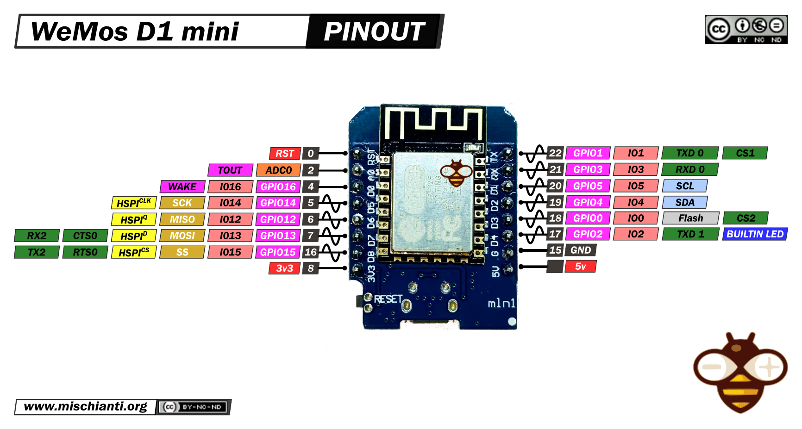
Our Microcontroller: The WeMos D1 Mini
Hilights
11 digital IO: all are interrupt and pwm capable (except D0/GPIO16)
1 analog input (3.2V max input): A0/ADC0
Micro USB or Type-C USB Port (clones usually have micro USB)
Two SPI interfaces (one is used for on-board flash memory), one I2C interface, two serial ports
Built-in WiFi (client or standalone access point modes) and Bluetooth
Compatible with MicroPython, Arduino, NodeMCU
Uses the CH340 USB-to-serial driver (installation usually needed on Windows)
Extremely low cost (approx $3.00 US on Amazon; one of the two least expensive components in your kits)

Slide 18
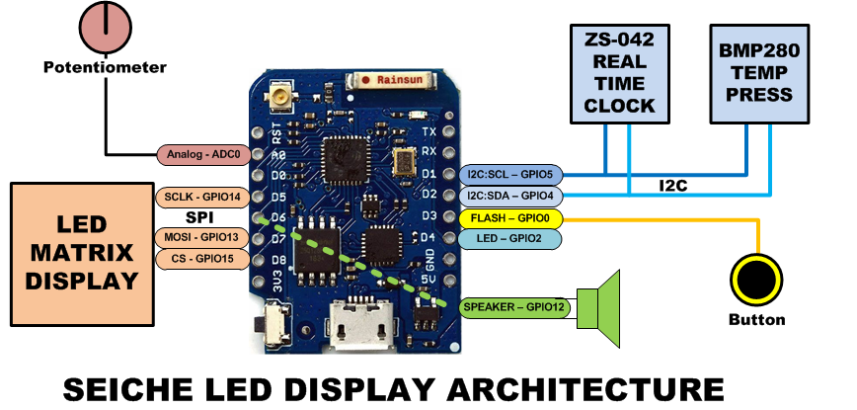
SEICHE LED Display Architecture
Red MAX7219 8x32 LED matrix display (SPI)
ZS-042 real-time clock module (I2C)
BMP280 Temperature and Pressure Sensor (I2C)
Piezoelectric speaker (PWM)
10KΩ Potentiometer (Analog-to-Digital Converter)
Button (Pullup and interrupt)

Slide 19
sprintf() Function Syntax
sprintf()’s formal syntax is: sprintf(char *buffer, const char *format, variable list)
buffer is an array of type char (the parameter when passed can also be a pointer [address] for such an array) which will contain the formatted output of the function
format is an unmodifiable (constant) array of char containing the format descriptors for all variables subsequently passed to the function, which is to say, it’s the format string.
The variable list are just the comma separated variables that are to be formatted
All variables passed in a single call to sprintf() are combined into a single output string
sprintf() automagically puts a terminating NULL (\0) at the end of the ASCII output

Slide 20
sprintf() Format Strings
sprintf() format strings contain conversion specifiers that specify how each individual variable is to be converted
sprintf() conversion specifiers have the following general syntax (all begin with a percent-sign):
%[flags][minimum field width][.][precision][length][conversion character]
% - special token that indicates the start of a conversion specifier
Flags – these modify the behavior of the specification
Minumum field width – as it says on the tin; this the minimum number of characters to be converted
. – The period is a separator between field width and precision
Precision – means one of the following depending on the variable type and conversion specifier
The maximum number of characters to be generated from a string
The number of digits after the decimal point for type float conversions (e, E, or f)
The zero-filled minimum number of digits for an integer
Conversion character – A single character which determines the output type of the conversion specifier; a single character that specifies the type of output format for the corresponding data or variable

Slide 21
sprintf() Conversion Specifiers
Below are the general conversion specifiers and what they do.
Specifier | What it does
d, i | int - integer; signed decimal notation
o | int – unsigned octal (no leading zero)
x, X | int – unsigned hexadecimal, no leading 0x
u | int – unsigned decimal
c | int – single character, after conversion to unsigned char
s | char * - characters from string are printed until \0 (NULL) or precision is reached
f | double – decimal notation of form [-]mmm.ddd where number of decimals is specified by precision; precision of zero (0) suppresses the decimals altogether
e, E | double - exp notation; default precision of 6, 0 suppresses
g, G | double – Use %f for <10^4 or %e for >10^4
p | void * - print output as a pointer, platform dependent
n | Number of characters generated so far; goes into output
% | No conversion, put a % percent sign in the output

Slide 22
sprintf() Conversion Specifiers
Below are the flags and what they do.
Flag | What it does
- | Left justification
+ | Always print number with a sign
spc (space) | Prefix a space if first character is not a sign
0 (zero) | Zero fill left for numeric conversions
# | Alternate output form depending on conversion character o – first digit will be zero x or X – 0x or 0X (respectively) prefixed to non-zero results e, E, f, g and G – Output will always have a decimal point g and G – trailing zeroes will never be removed

